Slide 1
Spanner: Google’s Globally-Distributed Database
Cheng Shiyang
Samuel Cherinet

Slide 2
Introduction
What is Spanner?
Highly Scalable
Semi-Relational
Features
Replication Configuration
Externally consistent read/write
Globally meaningful commit timestamps
SQL
True Time API

Slide 3
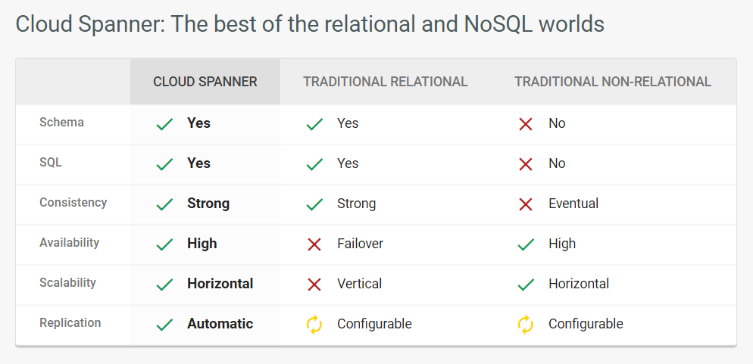

Slide 4
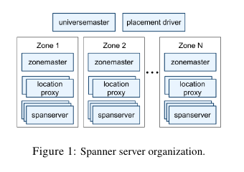
Implementation : Universe
Spanserver
Zonemaster
Location Proxy
Notes:
Zones : unit of administrative deployment
- zone master : assigns data to span server
- span server : serves data to the clients
- location proxy : by clients to locate data
-universe master : console status
-placement driver : automated moving of data

Slide 5
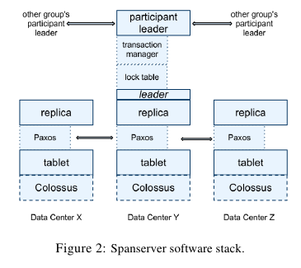

Spanserver
Tablet
Distributed Transaction
Replication
Colossus
Notes:
Tablet - data structure in span server
- (key:string, timestamp:int64)->string
Colossus - B-tree-like file where tablet's state is saved, it's a successor to google file system
-span server implements a single paxos on a tablet for replection
-utilizes long lived leaders with time based leader leases (10 sec)
-writes initiale paxos protoc at the leader, reads access state directly from the any replica that is upto date
-leader replica implements a lock table for concurrency control
-leader repllica implements a transaction manager
-transaction manager implements a participant leader, this doesn't need to kick in if the transaction involves data in the same paxos group there is no need to use the participant leader

Slide 6
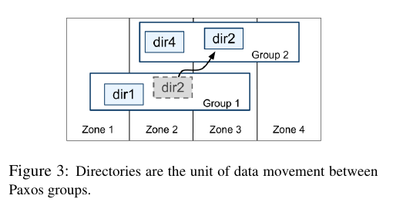
Directories
Prefixing for locality
Movedir
Administration
number/type of replicas
Geographic placement
Notes:
directory - a bucketing abstraction which is a set of contiguous keys that share a common prefix
movedir - background task used to move directories b/n paxos groups
- worth noting that it doesn't lock, it just registers that it started and use transaction eventually to do the nomial data

Slide 7
Data Model
Schematized semi-relational tables :
Rows must have name (one or more primary key columns)
Query Language
Similar to SQL but has support for protocol-buffer-values fields
Strongly Typed
Layered on top of the directory-bucketed key-value mappings supported by the implementation
Notes:
SQL - some extenstion to support protocol-buffer-valued fields
Semi-relational - rows must have names

Slide 8
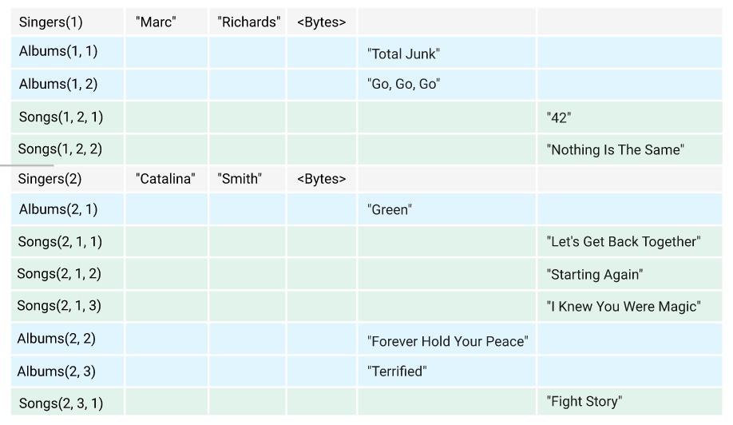
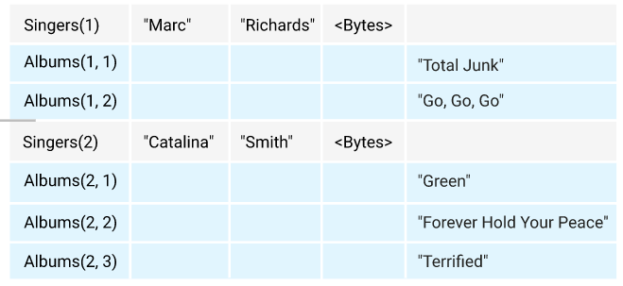
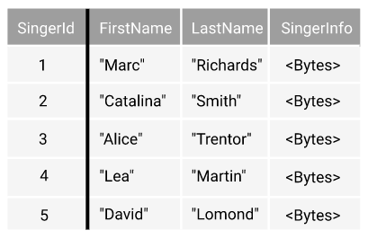
Example Physical Layout of Data

Slide 9
Predecessor/Other Data Models
Big Table
Megastore
Over 300 application use it in google
Relative low performance
Synchronous replication

Slide 10
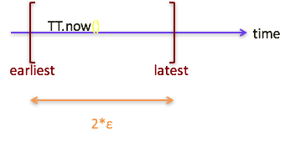
True Time
True Time APIs:
TT.now() //[earliest, latest]
TT.after(t)
TT.before(t)
Notes:
True time system provides three APIs. The first Api is TT.now. This api provides two timestamps which stand for a time interval. The true time system guaranteed the time interval contains the absolute current time. The after API will return true if t is after absolute current time. The before API is similar to the after API. This system provide a global clock for all nodes in the distributed system.

Slide 11
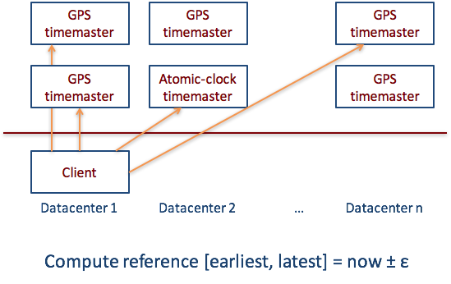
True Time Architecture
Marzullo’s Algorithm to detect and reject liars.

Slide 12
External Consistency
Transaction:T1, T2
If T1 commits before T2’s
T1’s ts < T2’s ts

Slide 13





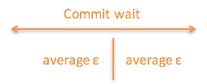
Timestamps and TrueTime
Notes:
This means it guarantee timestamp s happens after the start absolute time and before the absolute end time.

Slide 14
Commit Wait and 2-Phase Commit
Acquired Lock
Start Logging
End Logging
Release Lock
Pc
Acquired Lock
P1
Acquired Lock
P2
Prepared send s
Compute s for each
Compute Overall s
Commit wait done

Slide 15
Read-Write Transaction
Writes occur in a transaction are buffered at the client until commit
Read transaction will acquires read locks and then read most recent data
After read transaction client will apply two phase-commit
A non-coordinator-participant leader first acquires write locks, choose a timestamp then logs the prepare record
Coordinator participant first acquire the lock, skip the prepare phase and log the record
Before allowing any coordinator commit, it will wait for TT.after(s)
Any coordinator commit and release the lock

Slide 16
Read-Only Transaction
Define LastTS() to be the timestamp of the last committed
In single-Paxos group, If there is no prepare transactions, the assignment s = LastTS()
In multi-Paxos group, assign s = TT.now().latest
Notes:
Multi-version database. Manipulate data using approach that adding new versions. Writes becomes append new data. So the reading do not need block writes.

Slide 17
Schema-Change Transaction
Assign a timestamp in future, which registered in the prepare timestamp at time t
Reads and writes may proceed if their timestamp procede t
Reads and writes must block behind the schema-change transaction if their timestamp are after t

Slide 18
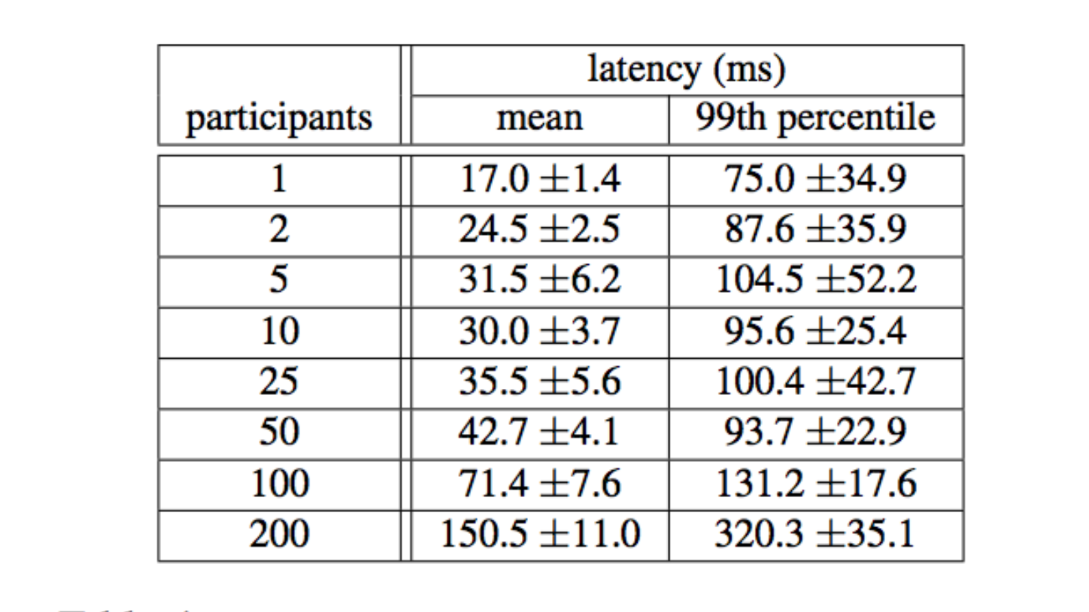
Evaluation - Two phase commit Scalability

Slide 19
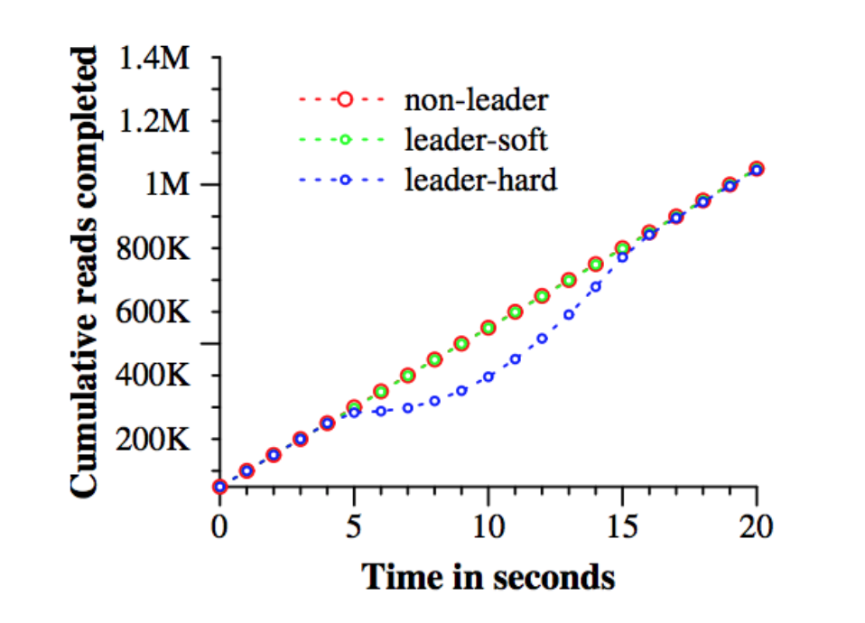
Evaluation - Availability
Notes:
The experiment arrange 5 zones. All leader are arranged in Z1 which is called leader zone. Killing non-leader zone make no impact to the throughput. Killing the leader zone while giving the leaders time to handoff leadership to a different zones has a minor effect, the throughput drop is not visible in the graph, but it is around 3-4%. On the other hand, killing leader zone with no warning has a severe effect, the rate of completion drop almost to 0. The Paxos leader leases are set 10 seconds. When kill the leader zone, after 10 seconds the leader will recovered.

Slide 20
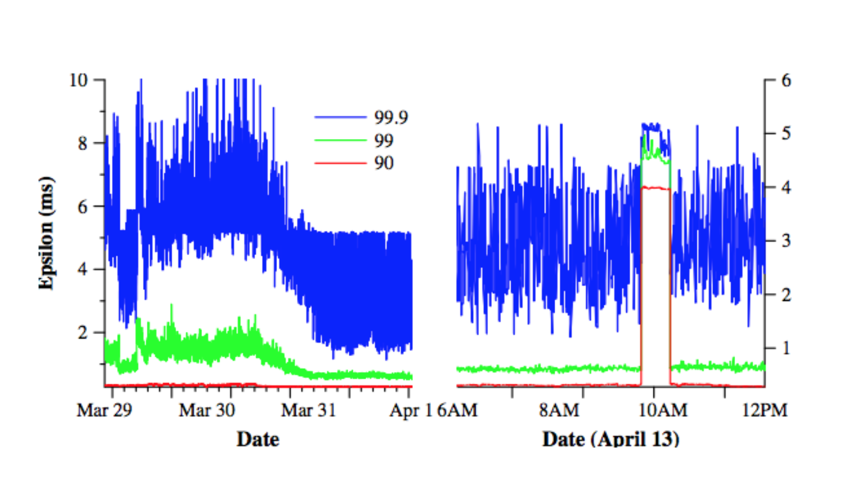
Evaluation - True Time
Notes:
The picture presents TT data taken at several thousand spanserver machines across datacenters up to 2200km apart. It plots the 90th, 99th, 99.9th percentiles of sampled at timeslave daemons immediately after polling the time master.

Slide 21
Question?

